Slide 1
2025 NASASPS Annual Meeting Regular Members

Slide 2
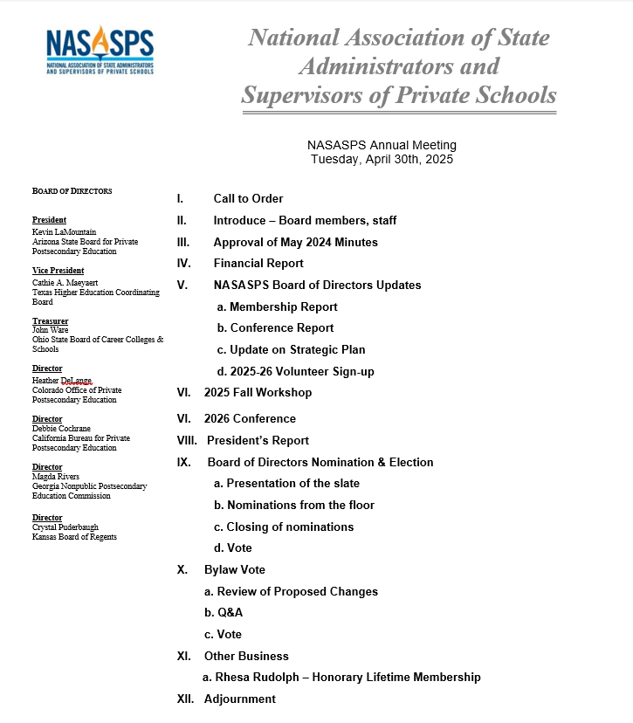
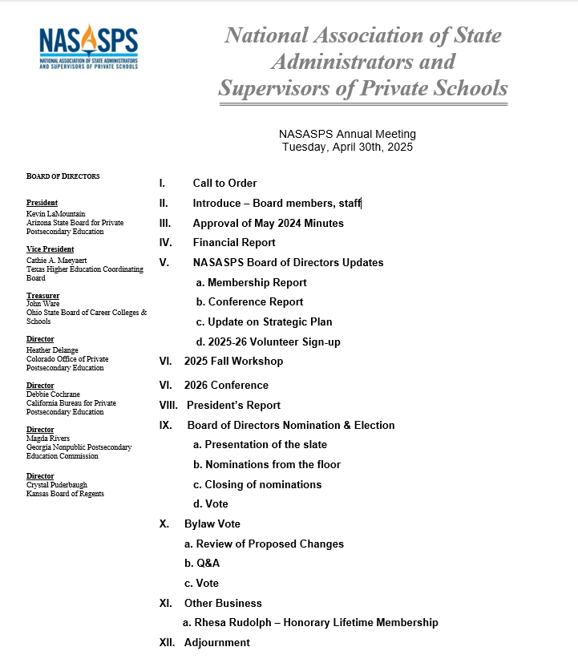

Slide 3
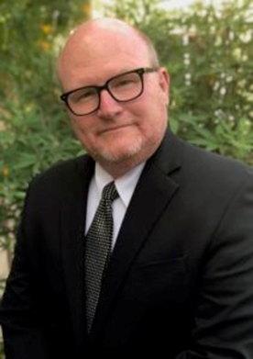
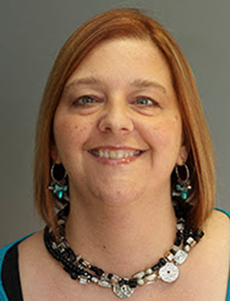
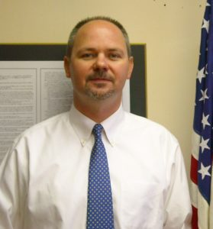
NASASPS Board of Directors - Officers
President Kevin LaMountain
Vice President Cam Maeyaert
Treasurer John Ware
Vice President Cam Maeyaert
Treasurer John Ware

Slide 4
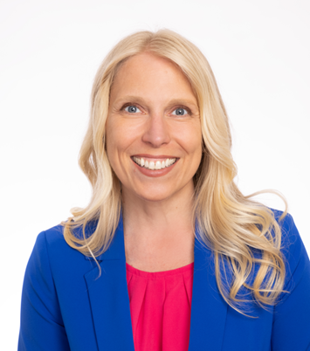
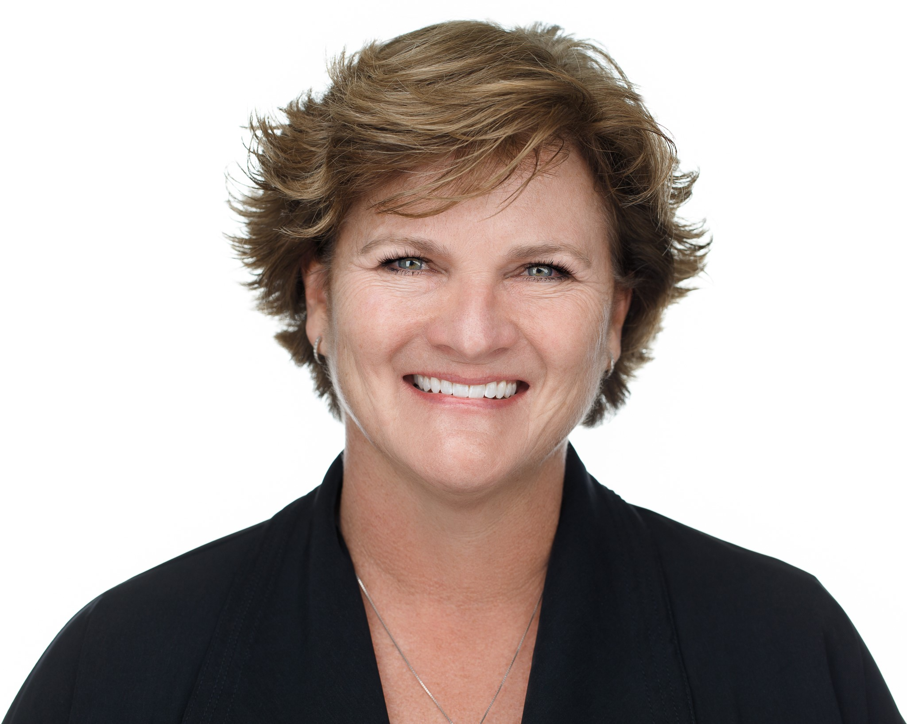
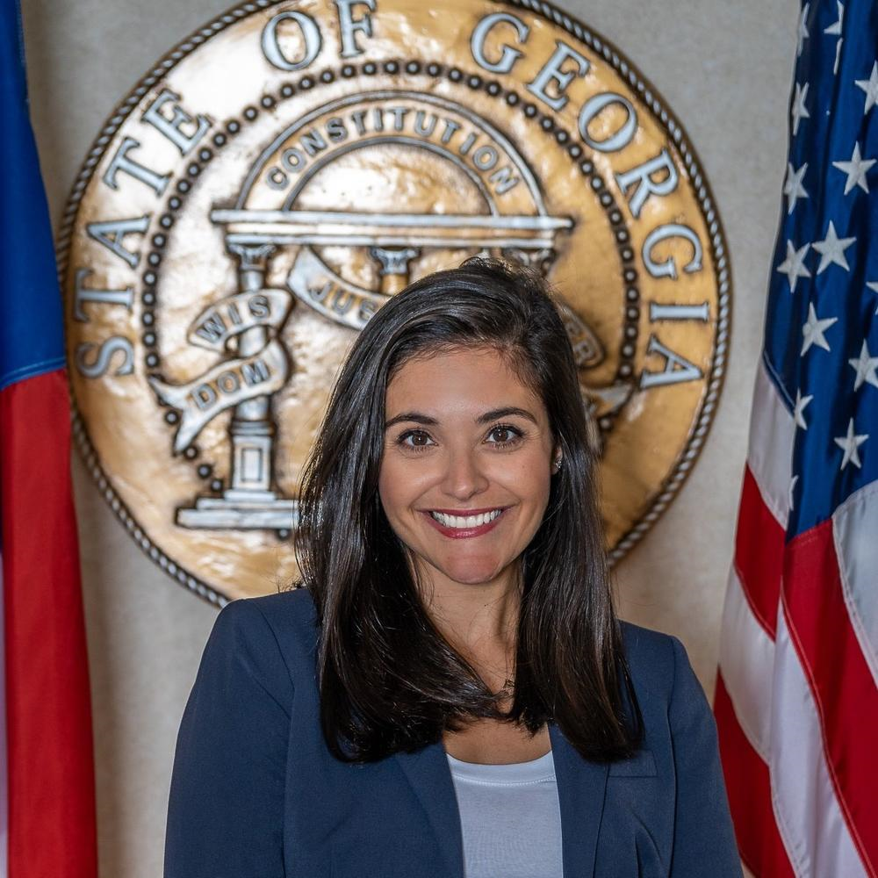
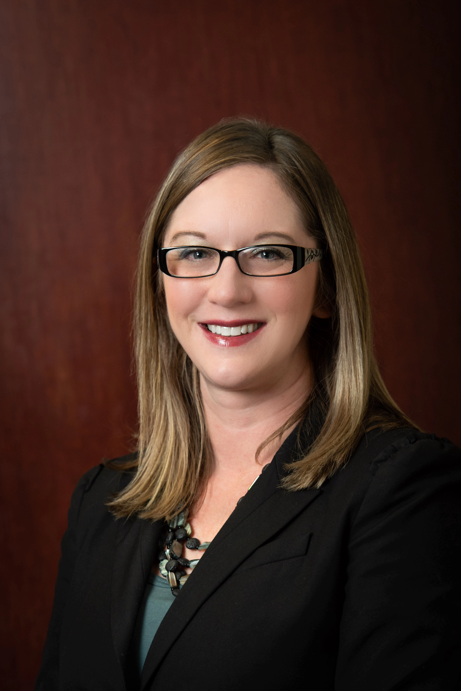
NASASPS Board of Directors - Directors
Debbie Cochrane | Heather DeLange | Maggie Rivers | Crystal Puderbaugh
President Kevin LaMountain
Vice President Cam Maeyaert
Treasurer John Ware
Vice President Cam Maeyaert
Treasurer John Ware

Slide 5
Approval of 2024 Annual Meeting Minutes Charleston, SC

Slide 6
Board of Directors Updates Treasurer’s Report

Slide 7
End-of-Year Comparison (Calendar FY)
December 31, 2024
Checking Account
$154,182.92
Money Market
$70,069.39
Investment Accounts
$259,036.63
Total assets: $497,482.98 (+8.7%)
December 31, 2023
Checking Account
$141,821.87
Money Market
$70,069.39
Investment Accounts
$241,771.87
Total assets: $457,797.06

Slide 8
December 31, 2024 – Actual vs. Budget
Actual
Budget
Revenue $241,119.97 $217,000.00
Expenditures $182,542.50 $213,202.00
Net Revenue $58,577.47 $3,798.00

Slide 9
Board of Directors Updates Membership Report

Slide 10
2025 Membership Report
Membership by Category
New Associate Members: 6
Associate Member Renewals: 29
Regular Members: 43
Partnership Members: 6

Slide 11
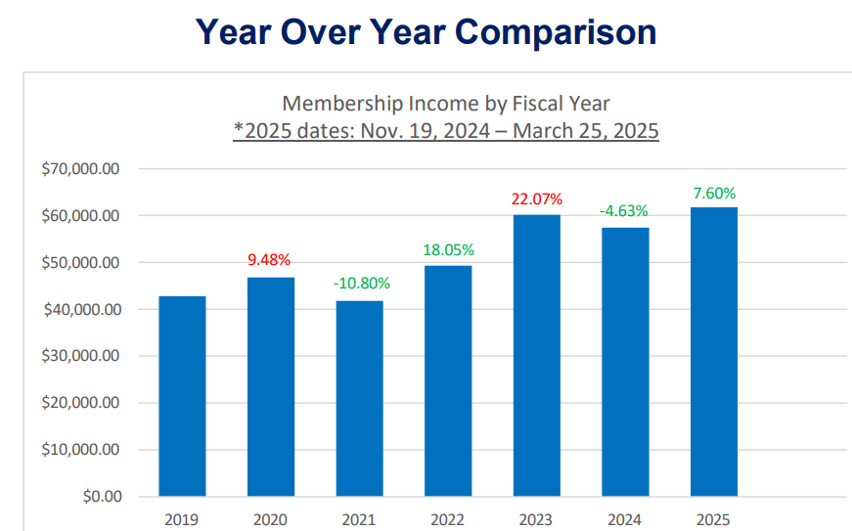
2024-25 Membership Revenue

Slide 12
Board of Directors Updates Conference Report

Slide 13
2025 Conference Report
2025 Registered Attendees (St. Louis) 220
2024 Registered Attendees (Charleston) 184
2023 Registered Attendees (Phoenix) 197

Slide 14
Board of Directors Updates Strategic Plan

Slide 15
2024-2026 Strategic Plan
2024-2026 Strategic Plan
NASASPS’ mission is to support state regulators for effective regulation of private postsecondary education.
Goal #1: Provide leadership, resources, and guidance to states on federal and state policy issues
Goal #2: Work to promote best practices and cohesion among members
Goal #3: Support strong consumer protection in private post-secondary education

Slide 16
2024-2026 Strategic Plan
NASASPS and Forj
Forj is an online community platform to strengthen connections, foster collaboration, and enhance the sharting of knowledge among our members.
Forj is a centralized space for members to engage in meaningful dialogue and access resources.
Forj will help NASASPS build a more informed, engaged, and collaborative community.

Slide 17
Volunteer Interest

Slide 18
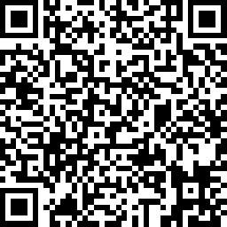
2024-2026 Strategic Plan
2025-26 Volunteer Interest
Sign up for volunteer opportunities
Sign up for the mentor/mentee program
Sign up to serve on the Fall Workshop Planning Committee

Slide 19
2025 Fall Workshop

Slide 20
2025 Fall Workshop Save the Date!
September 18-19
Chicago, IL
Hyatt Regency McCormick Place

Slide 21
2026 Conference

Slide 22
2026 Annual Conference Save the Date!
April 19-22
Dallas, TX
Renaissance Dallas

Slide 23
2026 Conference

Slide 24
President’s Report

Slide 25
Board of Directors Nomination & Election

Slide 26
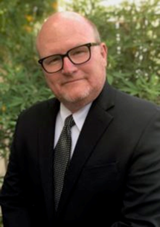
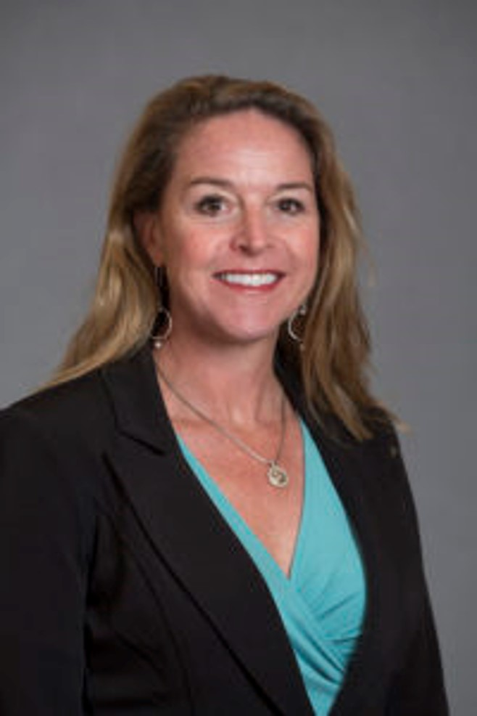
2024-2026 Strategic Plan
2025 Nominating Committee
Kevin LaMountain
Cam Maeyaert
Lorna Candler

Slide 27
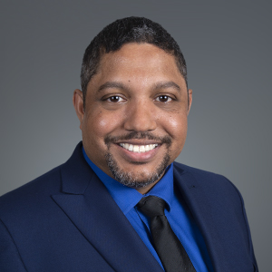
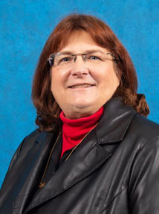
2024-2026 Strategic Plan
2025 NASASPS Board of Directors Nominees
Heather DeLange
Sean Seepersad
Kim Verneuille

Slide 28
2024-2026 Strategic Plan
2025 NASASPS Board of Directors Nominees
Nominations from the Floor

Slide 29
2024-2026 Strategic Plan
2025 NASASPS Board of Directors Nominees
Closing of Nominations and Vote

Slide 30
Bylaw Vote Review of Proposed Changes

Slide 31
Bylaw Vote
Announced last month
Clarifies language concerning the Secretary position (allowing for a member of management to be Secretary)
Specifies audit schedule (every three years)
Clarifies qualifications for election to the Board (all board members are regular members)
Removes a strikethrough present on printed copies of the bylaws outlining board positions
Bylaws may be amended by a two-thirds vote of the members entitled to vote (regular members)

Slide 32
Questions?

Slide 33
2024-2026 Strategic Plan
2025 Bylaw Vote
Each regular member state board, commission, agency,
or department shall be entitled to one vote
Staff contact registered regular members to determine their
voting delegate
Voting delegates will cast their votes via paper ballots. Ballots have
been given to voting delegates
Staff will collect ballot at the end of the meeting.
Bylaw changes must be approved by a 2/3 majority

Slide 34
Other Business

Slide 35
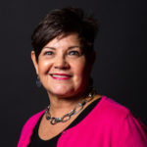
2024-2026 Strategic Plan
Honorary Lifetime Membership Award
Rhesa Rudolph

Slide 36
2024-2026 Strategic Plan
2024-25 NASASPS Vice President
Cam Maeyaert

Slide 37
2024-2026 Strategic Plan
2024-25 NASASPS President
Kevin LaMountain

Slide 38
Thank you!

