Slide 1
2025 NASASPS Business Meeting All Member

Slide 2
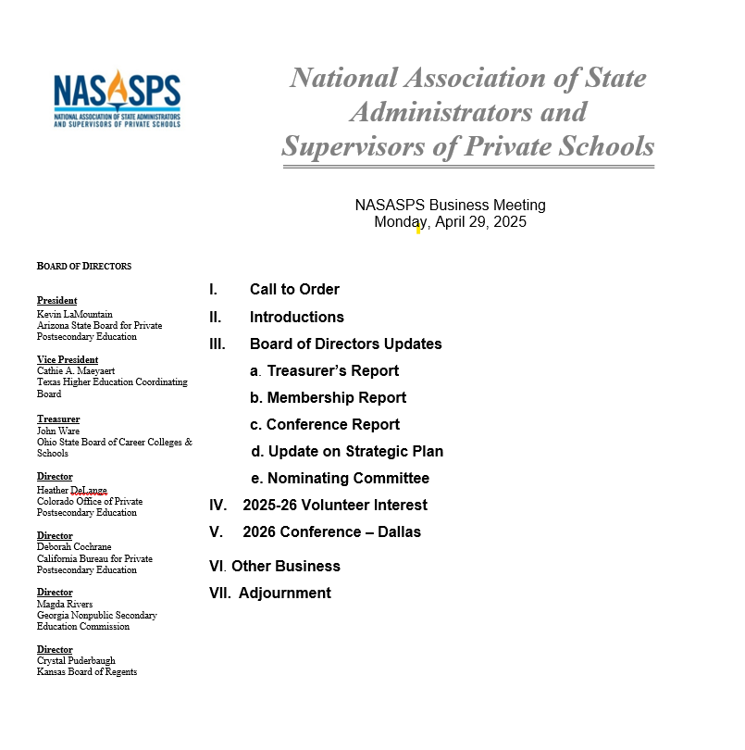

Slide 3
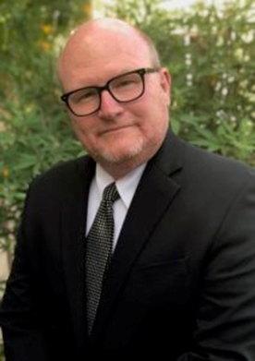
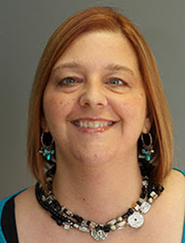
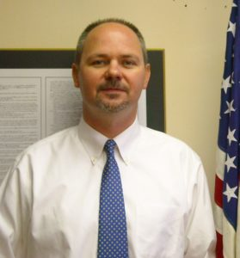
NASASPS Board of Directors - Officers
President Kevin LaMountain
Vice President Cam Maeyaert
Treasurer John Ware
Vice President Cam Maeyaert
Treasurer John Ware

Slide 4
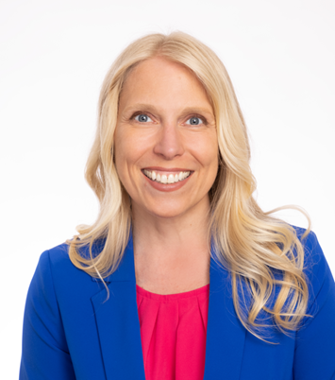
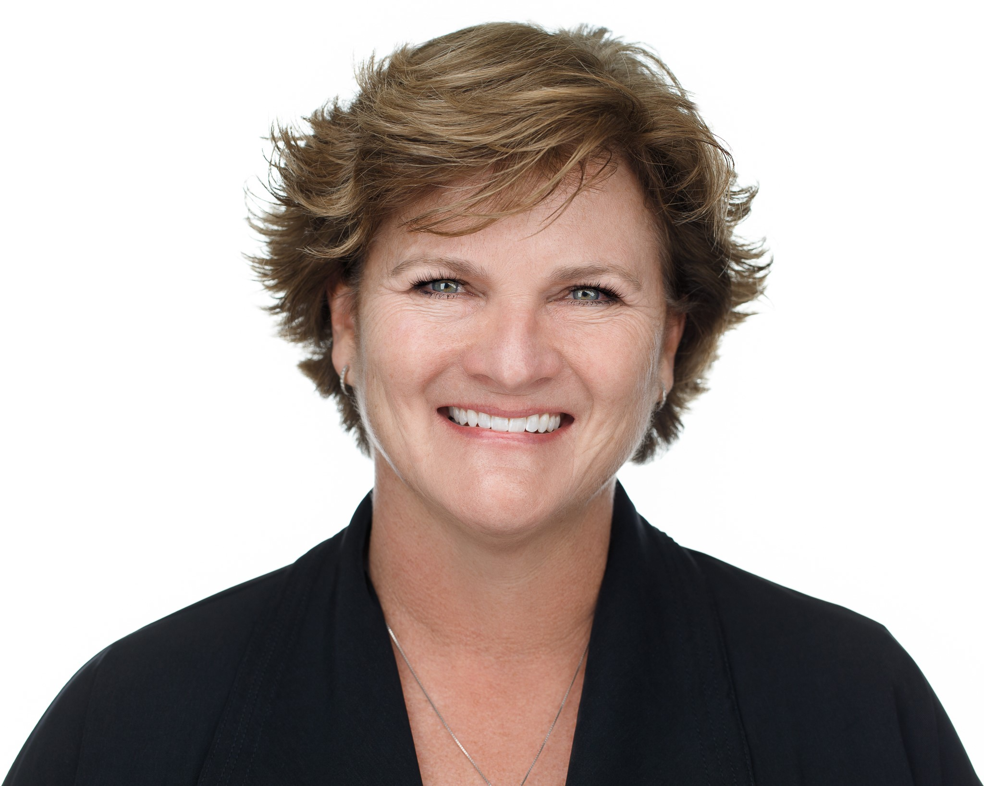
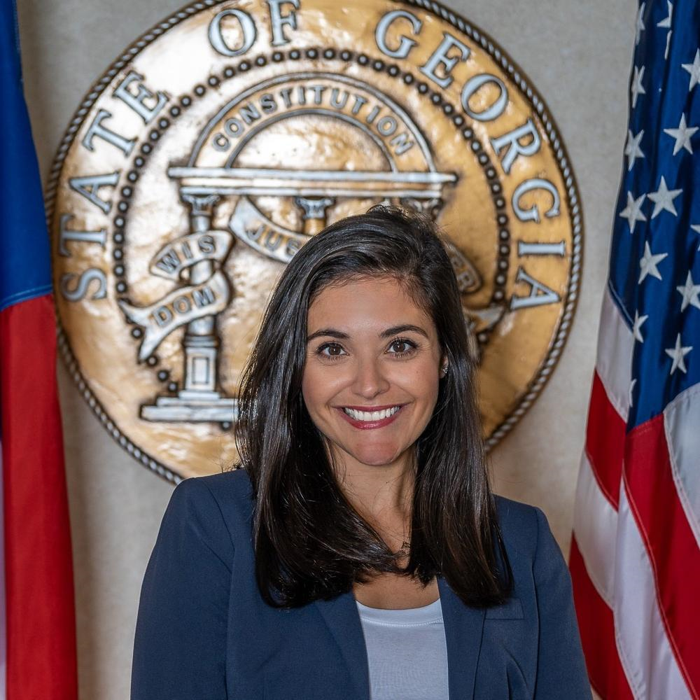
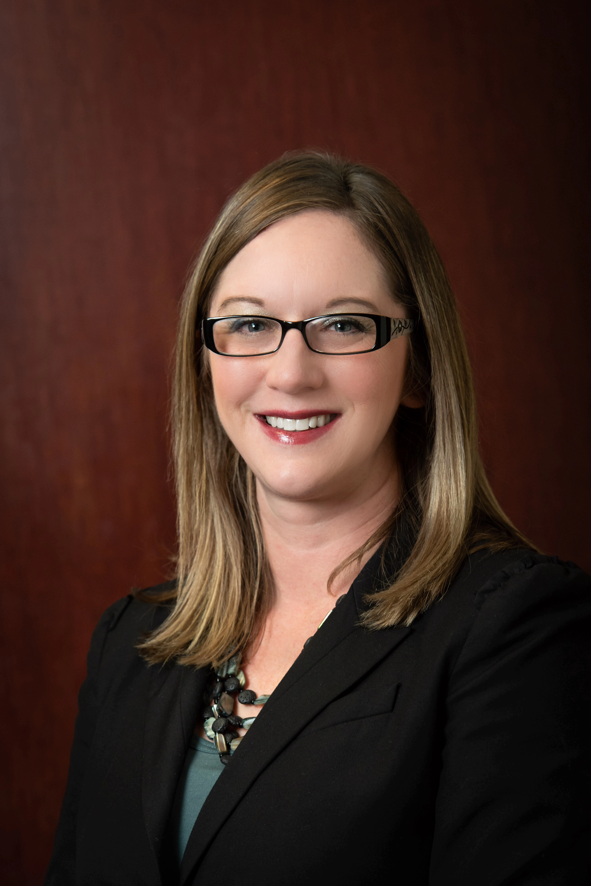
NASASPS Board of Directors - Directors
Debbie Cochrane | Heather DeLange | Maggie Rivers | Crystal Puderbaugh
President Kevin LaMountain
Vice President Cam Maeyaert
Treasurer John Ware
Vice President Cam Maeyaert
Treasurer John Ware

Slide 5
Board of Directors Updates Financial Report

Slide 6
End-of-Year Comparison (Calendar FY)
December 31, 2024
Checking Account
$154,182.92
Money Market
$70,069.39
Investment Accounts
$259,036.63
Total assets: $497,482.98 (+8.7%)
December 31, 2023
Checking Account
$141,821.87
Money Market
$70,069.39
Investment Accounts
$241,771.87
Total assets: $457,797.06

Slide 7
December 31, 2024 – Actual vs. Budget
Actual
Budget
Revenue $241,119.97 $217,000.00
Expenditures $182,542.50 $213,202.00
Net Revenue $78,577.47 $3,798.00

Slide 8
Board of Directors Updates Membership Report

Slide 9
2025 Membership Report
Membership by Category
New Associate Members: 6
Associate Member Renewals: 29
Regular Members: 43
Partnership Members: 6

Slide 10
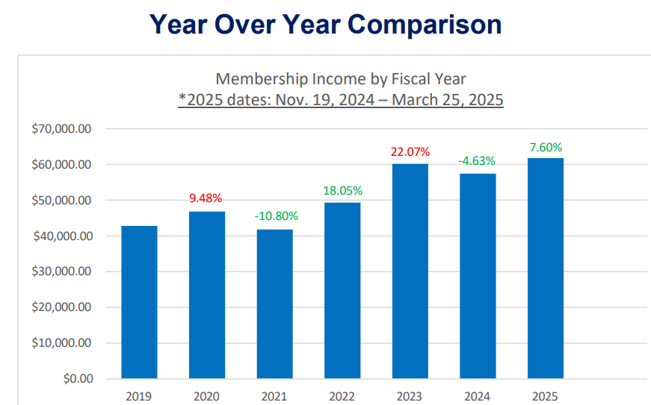
2024-25 Membership Revenue

Slide 11
Board of Directors Updates Conference Report

Slide 12
2025 Conference Report
2025 Registered Attendees (St. Louis) 218
2024 Registered Attendees (Charleston) 184
2023 Registered Attendees (Phoenix) 197

Slide 13
Board of Directors Updates Strategic Plan

Slide 14
2024-2026 Strategic Plan
2024-2026 Strategic Plan
NASASPS’ mission is to support state regulators for effective regulation of private postsecondary education.
Goal #1: Provide leadership, resources, and guidance to states on federal and state policy issues
Goal #2: Work to promote best practices and cohesion among members
Goal #3: Support strong consumer protection in private post-secondary education

Slide 15
2024-2026 Strategic Plan
NASASPS and Forj
Forj is an online community platform to strengthen connections, foster collaboration, and enhance the sharting of knowledge among our members.
Forj is a centralized space for members to engage in meaningful dialogue and access resources.
Forj will help NASASPS build a more informed, engaged, and collaborative community.

Slide 16
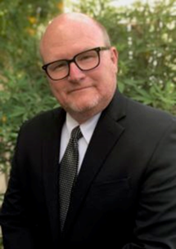
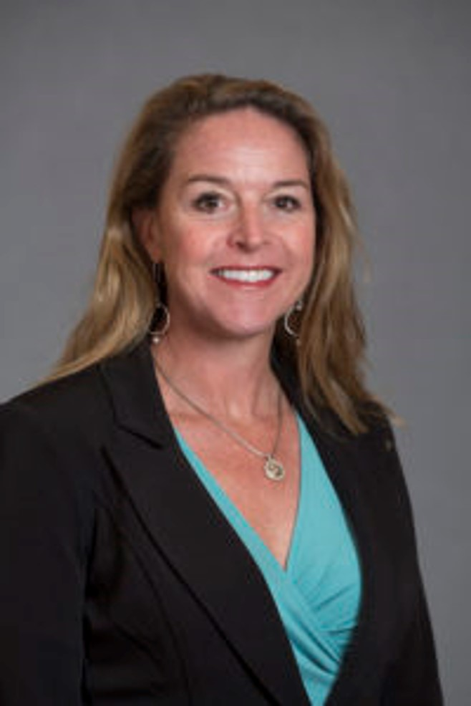
2024-2026 Strategic Plan
2025 Nominating Committee
Kevin LaMountain
Cam Maeyaert
Lorna Candler

Slide 17
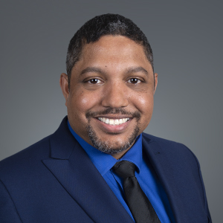
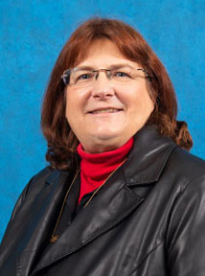
2024-2026 Strategic Plan
2025 NASASPS Board of Directors Nominees
Heather DeLange
Sean Seepersad
Kim Verneuille

Slide 18
Board of Directors Volunteer Interest

Slide 19
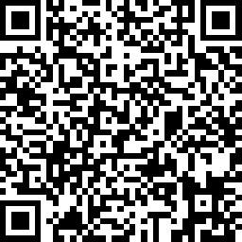
2024-2026 Strategic Plan
2025-26 Volunteer Interest
Sign up for volunteer opportunities
Sign up for the mentor/mentee program

Slide 20
2026 Conference

Slide 21
2026 Annual Conference Save the Date!
April 19-22
Dallas, TX
Renaissance Dallas

Slide 22
Other Business Bylaw Vote

Slide 23
Bylaw Vote
Announced last month
Clarifies language concerning the Secretary position
Specifies audit schedule
Clarifies qualifications for election to the Board
Removes a strikethrough present on printed copies of the bylaws outlining board positions
Bylaws may be amended by a two-thirds vote of the members entitled to vote (regular members)

Slide 24
Questions?

Slide 25
Thank you!

